Slide 1

Manufacturing Analysis
Presented By
Mr Uzair Patel
Ms. Monica Ramani
Ms. Taiba Asif Chaus
Mr. Reddy Eswar Thai Babu
Mr. Prajwal Jadhao
Mr. Sk. Mahabu Subhani

Slide 2
Introduction
In this report, we delve into key aspects essential for evaluating and enhancing production performance, including employee-wise rejected quantity, machine-wise rejected quantity, production comparison trends, manufacture versus rejected ratios, and department-wise manufacture versus rejected analysis. Each of these metrics offers valuable insights into different facets of production, enabling informed decision-making and targeted improvements to streamline operations and enhance overall productivity and quality control. Let's explore each of these components in detail to gain a holistic understanding of production dynamics and identify areas for optimization.

Slide 3
Key Performance Indicators:
Employee Wise Rejected Qty
Machine Wise Rejected Qty
Production Comparison trend
Manufacture Vs Rejected
Department Wise Manufacture Vs Rejected
Emp Wise Rejected Qty

Slide 4
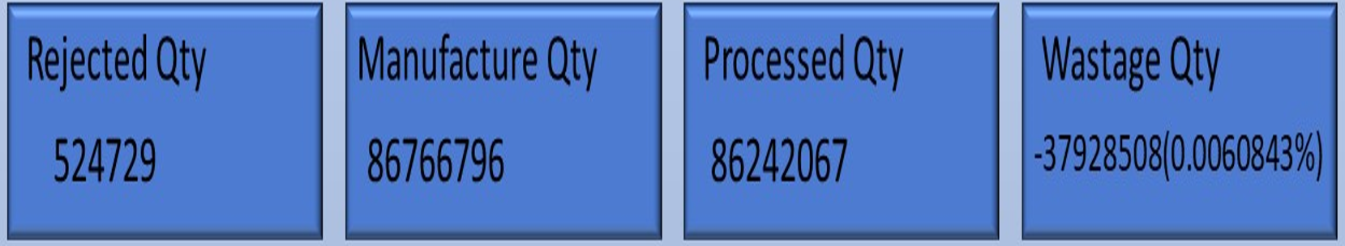

Slide 5
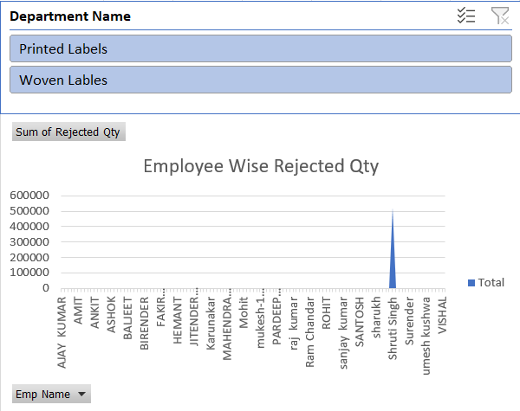
1. Employee Wise Rejected Qty
Identified employees with consistently high rejection rates, indicating potential training or performance improvement needs.
Recognized employees with low rejection rates as examples of effective workmanship.
Here we see that sruthi singh have high rejected qty - 520867

Slide 6
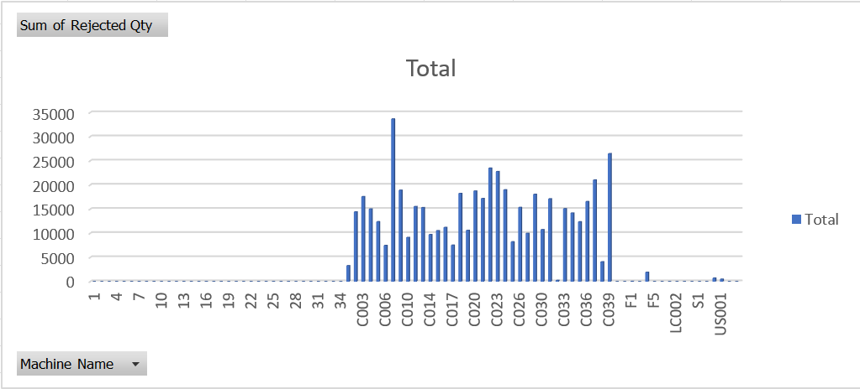
2. Machine Wise Rejected Qty
Highlighted specific machines prone to defects, signaling the need for maintenance or replacement to improve overall production quality.
Identified patterns of machine-related issues impacting rejection rates, allowing for targeted interventions to minimize defects.
Here machine c007 - 33660

Slide 7
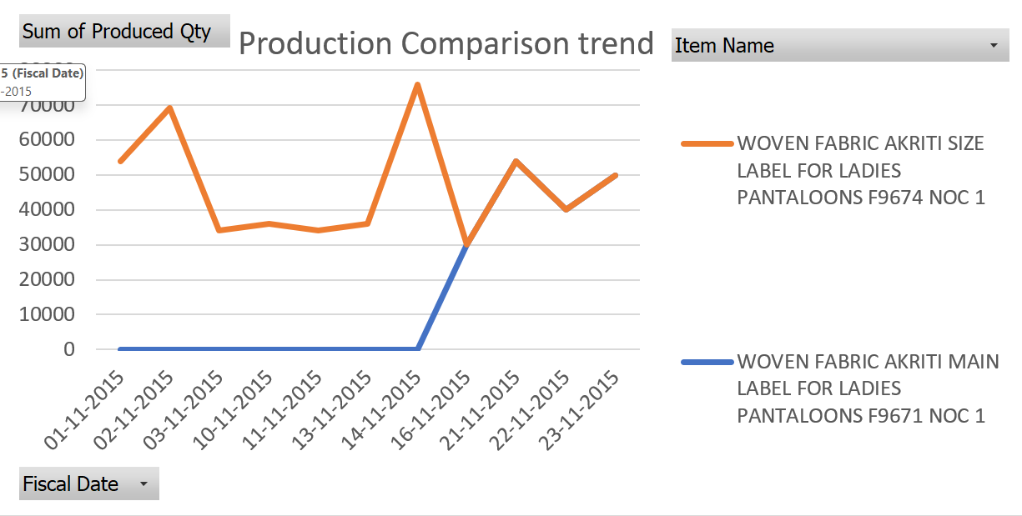
3. Production Comparison trend
Revealed periods of fluctuating production output and quality, indicating potential inefficiencies or variability in production processes.
Identified trends over time, enabling proactive adjustments to maintain consistent production standards and meet targets.
Here on nov 13 2015 at 9 am – 4282551 quantity have been produced

Slide 8
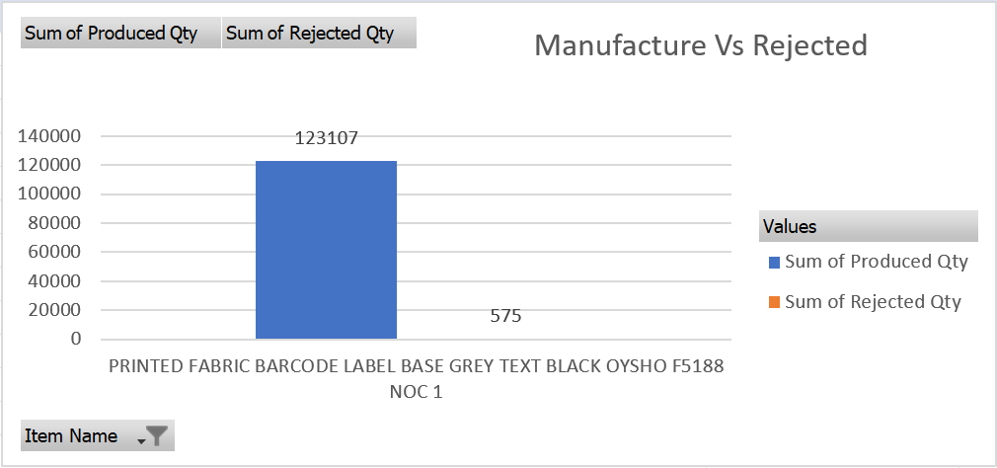
4. Manufacture Vs Rejected
Showcased the overall effectiveness of quality control measures in the production process.
Highlighted areas where improvements in quality control could lead to significant reductions in rejected products and associated costs.

Slide 9
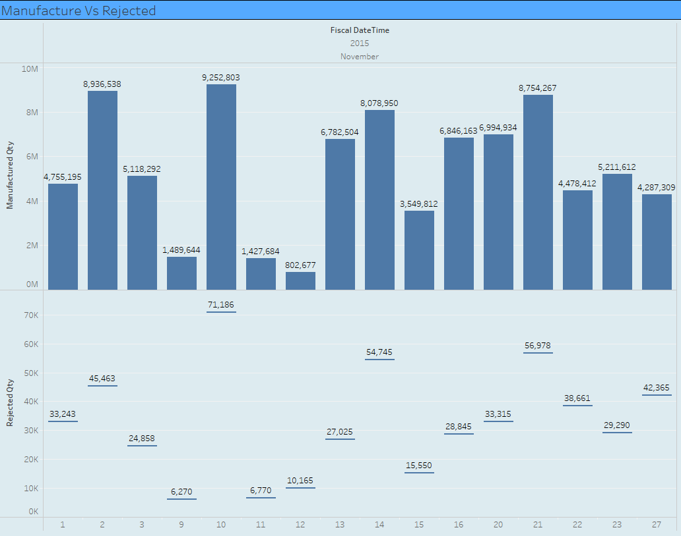
5. Department Wise Manufacture Vs Rejected
Identified departments with higher rates of rejected products, pinpointing areas for targeted process improvements or resource allocation.
Recognized departments with lower rejection rates as models for effective quality management practices.

Slide 10
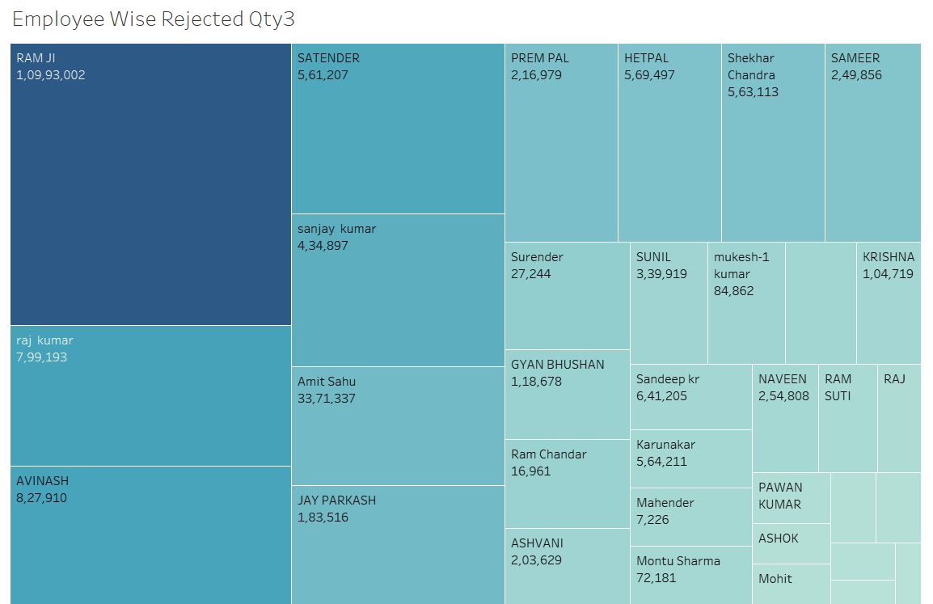
6. Emp Wise Rejected Qty
Provided insights into individual employee performance and its impact on product quality.
Facilitated the identification of employees in need of additional support or training to reduce rejection rates and improve overall efficiency.

Slide 11
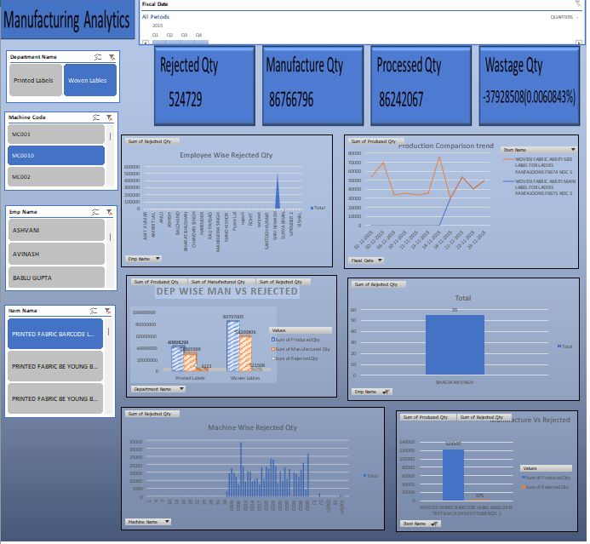
Excel Dashboard

Slide 12
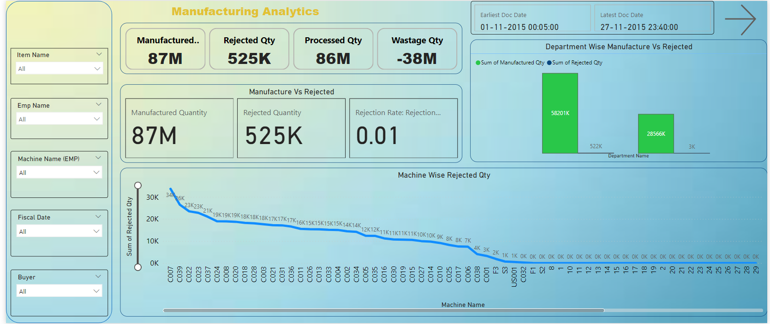
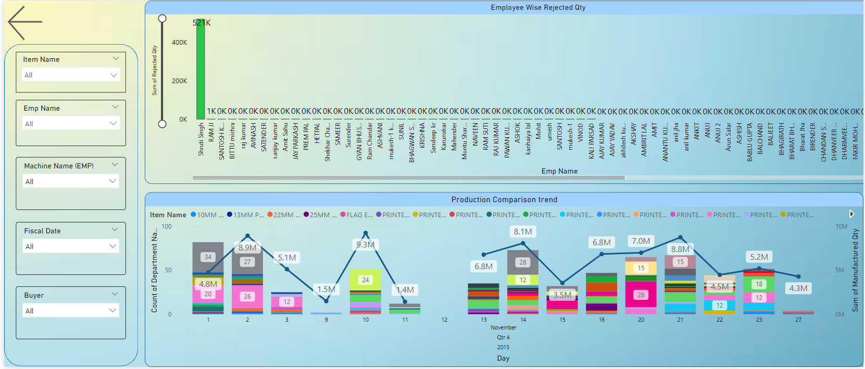
Power BI Dashboard

Slide 13
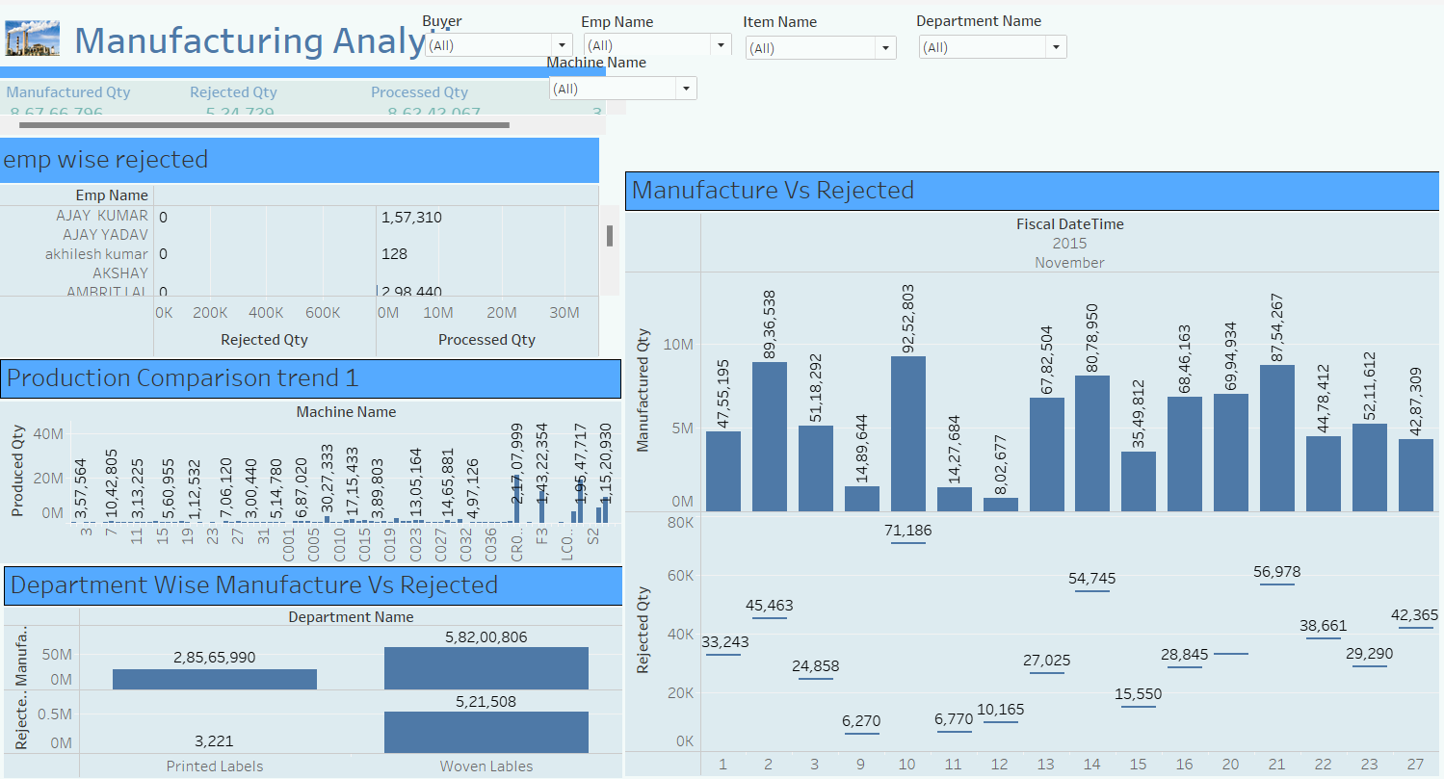
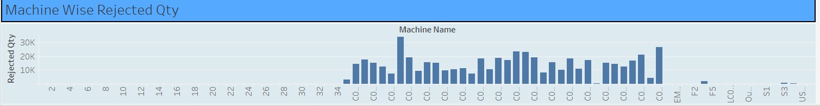
Tableau Dashboard

Slide 14
Recommendation
Conduct regular training to enhance skills and reduce errors.
Implement preventive maintenance schedules.
Upgrade or replace outdated machinery.
Install real-time monitoring systems.
Analyze root causes for fluctuations.
Enhance quality control measures.
Establish clear communication channels.

Slide 15
Conclusion
Identified areas for improvement and provided targeted support to enhance employee performance and reduce defects.
Addressed equipment issues promptly to optimize machine performance and minimize defects caused by machinery malfunction.
Monitored fluctuations in output and quality over time to implement proactive measures for maintaining consistency and meeting production targets efficiently.
Strived to reduce the ratio of manufactured items to rejected ones through process improvements and quality control measures to enhance product quality and minimize waste.
Highlighted areas of strength and weakness within departments to optimize efficiency and quality in specific areas, improving overall organizational performance.

Slide 16
THANK YOU

